Slide 1


SMART WATER SUPPLY MANAGEMENT
Project: Design for Analog Electronics and Industrial Instrumentation
Presented By:
Sujata Gupta (21250)
Patil Sarvjit Ajit (20862)
Kirteyman Singh Rajput (21760)

Slide 2
Problem Statement
To automate the current water supply on rooftop tank in DESE
Sources of Supply
Borewell
IISc main water resource
Current Management
Manual ON/OFF management

Slide 3
Current Scenario
T1
DESE
From IISc main water resource
T2
P2
P1
P: Pump
T: Tank
Submersible

Slide 4


Proposed Solution
T1
DESE
From IISc main water resource
T2
P2
C
P1
P: Pump
T: Tank
C: Controller
Submersible

Slide 5
Components at Stages
T1,T2: Level Sensors, nRF24L01
P1,P2: nRF24L01, Pump Controller
C: nRF24L01, Display Message
Same nRF will be shared by T2 and P2

Slide 6
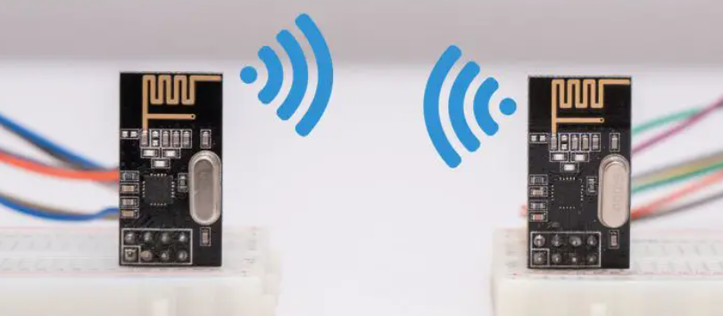
nRF24L01
SPI Communication
Frequency Range: 2.4 GHz ISM band
Communication distance: 100 m
Operating Voltage: 1.9 - 3.6V
Rate: up to 2 Mbps
Current : 12 mA during transmission mode
Less than a single LED (30 mA)
Specially designed for ultra low power applications
Image Courtesy: Google

Slide 7
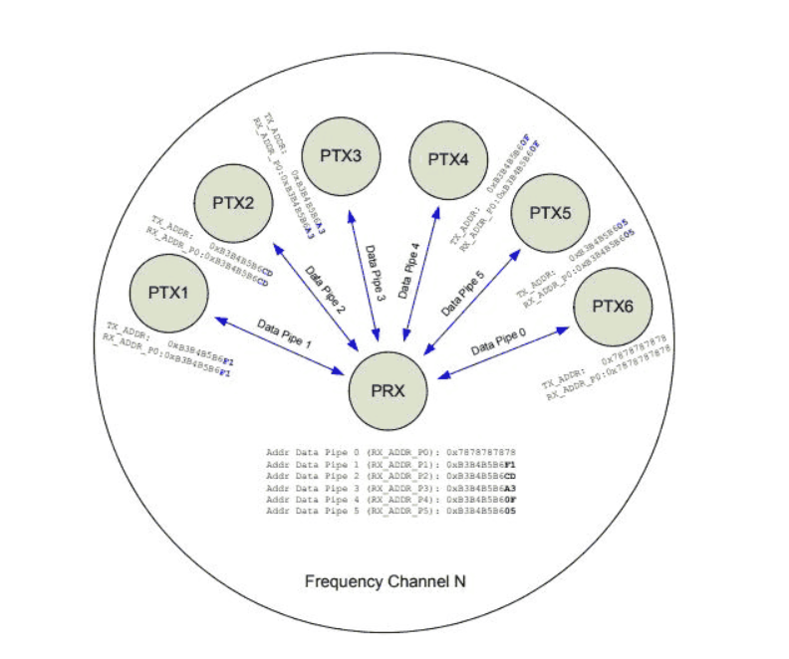
nRF24L01
Can use 125 different channels
Each channel has up to 6 addresses i.e. can use 6 other devices simultaneously
PRX: Primary Receiver
PTX: Primary Transmitter
The multi-receiver capacity of nRF24L01 is having up to 6 channels (pipes) of radio communication
Receiving or read mode simultaneously
Each PTX node links to one of these pipes to use both in transmitting and receiving
Image Courtesy: Google

Slide 8
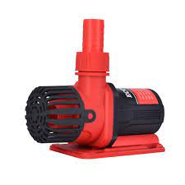

Block Diagram of PCB
Microcontroller
nRF24L01
Relay
Water Pump
3.3 Volts
5 Volts
AMS1117
5 Volts
Power Supply
Water Level Sensor

Slide 9
Thank You

